Slide 1

Topic C SQL QUERY 2 (Row-wise/Aggregate Functions/Summarizing Results By Group)

Slide 2
SQL Query 2 (Row-wise/Aggregate Functions/Summarizing Results By Group)
CONTENT
Row-wise operations
Aggregate functions
Summarizing results by group

Slide 3

Row-wise operation
Product_Code | Selling_price | Prod_Description | Accessory _price
HG5000 | 17.60 | Body Pants + bell | 2.40
RQ8996 | 22.00 | Dress Yellow | NULL
DT4000 | 17.20 | Top + Skirt White + necklace | 12.80
RQ7601 | 26.50 | Dress Colour | NULL
What is the total selling price for each product?
How much will it cost if I buy 5 of each product?
Product
Original cost price table |  |  | Total selling price per product | Total selling price for 5
Product_code | Selling_price | Accessory_price | Selling_price + accessory_pice | (Selling_price + accessory_price) * 5
HG5000 | 17.60 | 2.40 | 20 | 100
RQ8996 | 22 | NULL | NULL | NULL
DT4000 | 17.20 | 12.80 | 30 | 150
RQ7601 | 26.50 | NULL | NULL | NULL

Slide 4
Row-wise operation
Orignal cost price table |  |  | Total selling price per item | Total selling price for 5 items
Product_code | Selling_price | Accessory_price | Selling_price + accessory_price | (Selling_price + accessory_price) * 5
HG5000 | 17.60 | 2.40 | 20 | 100
RQ8996 | 22 | NULL | NULL | NULL
DT4000 | 17.20 | 12.80 | 30 | 150
RQ7601 | 26.50 | NULL | NULL | NULL
What is the total selling price for each product?
How much will it cost if I buy 5 of each product?
Product
SQL
SELECT
Product_code ‘Product code’, Prod_Description ‘Product description’ ,
Selling_price ‘Unit price’, Accessory_price ‘Accessory price’,
Selling_price + accessory_price ‘Total selling price’,
(Selling_price + accessory_price) * 5 ‘Total selling price for 5’
FROM Product

Slide 5
Row-wise operation
SQL
SELECT
product_code ‘Product code’, Prod_Description ‘Product description’ ,
Selling_price ‘Selling price’, accessory_price ‘Accessory price’,
Selling_price + accessory_price ‘Total selling price’,
(Selling_price + accessory_price) * 5 ‘Total selling price for 5’
FROM Product
Product code | Product description | Selling price | Accessory price | Total selling price | Total selling price for 5 items
HG5000 | Body pants + bell | 17.60 | 2.40 | 20 | 100
RQ8996 | Dress yellow | 22 | NULL | NULL | NULL
DT4000 | Top + White dress + necklace | 17.20 | 12.80 | 30 | 150
RQ7601 | Dress colour | 26.50 | NULL | NULL | NULL
If one of the columns involve in a column expression is NULL, the column expression returns a NULL
Resulting Table

Slide 6
Row-wise operations - ISNULL function
Product code | Product description | Selling price | Accessory price | Total selling price | Total selling price for 5 items
HG5000 | Body pants + bell | 17.60 | 2.40 | 20 | 100
RQ8996 | Dress yellow | 22 | NULL | NULL | NULL
DT4000 | Top + White dress + necklace | 17.20 | 12.80 | 30 | 150
RQ7601 | Dress colour | 26.50 | NULL | NULL | NULL
Resulting Table
How to resolve the NULL issue?
If argument1 is NULL, then return argument2
If argument1 is not NULL, then return argument 1
ISNULL (argument1, argument2)

Slide 7
Row-wise operation - ISNULL function
Product code | Product description | Selling price | Accessory price | Total selling price | Total selling price for 5 items
HG5000 | Body pants + bell | 17.60 | 2.40 | 20 | 100
RQ8996 | Dress yellow | 22 | NULL | NULL | NULL
DT4000 | Top + White dress + necklace | 17.20 | 12.80 | 30 | 150
RQ7601 | Dress colour | 26.50 | NULL | NULL | NULL
Product
SQL
SELECT product_code ‘Product code’, Prod_Description ‘Product description’ , Selling_price ‘Selling price’ accessory_price ‘Accessory price’, ISNULL(selling_price, 0) + ISNULL(accessory_price, 0) ‘Total selling price’, (ISNULL(selling_price. 0) + ISNULL(accessory_price, 0)) * 5 ‘Total selling price for 5’
FROM Product
ALL NULL REPLACE BY 0
Resulting Table
Product code | Product description | Selling price | Accessory price | Total selling price | Total selling price for 5 items
HG5000 | Body pants + bell | 17.60 | 2.40 | 20 | 100
RQ8996 | Dress yellow | 22 | NULL | 22 | 110
DT4000 | Top + White dress + necklace | 17.20 | 12.80 | 30 | 150
RQ7601 | Dress colour | 26.50 | NULL | 26.50 | 132.50

Slide 8
Row-wise operation - Using numeric operator in expression
A subexpression in the bracket is evaluated first
Unit_px / (ISNULL (accessary_px) + Unit_px * 2.0)

Slide 9
Row-wise operation - Using string operator in expression
Product_Code | Selling_price | Prod_Description | Accessory _price
HG5000 | 17.60 | Body Pants + bell | 2.40
RQ8996 | 22.00 | Dress Yellow | NULL
DT4000 | 17.20 | Top + Skirt White + necklace | 12.80
RQ7601 | 26.50 | Dress Colour | NULL
To display the product code with description by embedding a space between them. Example: RQ8996 Dress Yellow
Product
SQL
SELECT product_code + ‘ ‘ + prod_description as Name_of_Product
FROM Product
Name_of_Product
HG5000 Body pants + bell
RQ8996 Dress yellow
DT4000 Top + White dress + necklace
RQ7601 Dress colour
The ‘+’ sign represents the string operation known as concatenation.
The ‘ ‘ represents a space.
Resulting Table

Slide 10
Row-wise opeataion - Using built-in function – SUBSTRING()
Product_Code | Selling_price | Prod_Description | Accessory _price
HG5000 | 17.60 | Body Pants + bell | 2.40
RQ8996 | 22.00 | Dress Yellow | NULL
DT4000 | 17.20 | Top + Skirt White + necklace | 12.80
RQ7601 | 26.50 | Dress Colour | NULL
How to extract 3 characters starting from 2nd character of the description? Example: ody from Body Pants + bell
Product
Start from 2nd character
SQL
SELECT prod_description, SUBSTRING(prod_description, 2, 3) as ‘Extract 3 characters from 2nd position’
FROM Product
Extract 3 characters
Prod_Description | Extract 3 characters from 2nd positioin
Body Pants + bell | ody
Dress Yellow | res
Top + Skirt White + necklace | op
Dress Colour | res
To extract part of the string.
Resulting Table

Slide 11
Row-wise operation - Using Day, Month, Year function to extract dd, mm, yyyy of a date attribute
Email | Password | DOB
LindaS@hotmail.com | Abc123 | NULL
DavidL@gmail.com | Da12lee | 13/09/1997
LSoh@hotmail.com | Abc123 | 20/12/1998
To list the year each customer was born.
Customer
SQL
SELECT email, dob, YEAR(dob) Year_of_Birth
FROM Customer
Email | DOB | Year_of_Birth
LindaS@hotmail.com | NULL | NULL
DavidL@gmail.com | 13/09/1997 | 1997
LSoh@hotmail.com | 20/12/1998 | 1998
To extract the year from the date.
Resulting Table

Slide 12
Row-wise operation Summary of built-in functions
Function | Output
GETDATE() | Current date/time
UPPER(string) | Convert string to uppercase
LOWER(string) | Convert string to lowercase
SUBSTRING(Source, s, l) | Part of source starting at position s of length l
LEN(string) | The number of character of source
Cast(columnName as datatype(size)) | To change datatype for a given column/expression
Convert(datatype(size), columnName, [style]) | To change datatype for a given column/expresession

Slide 13
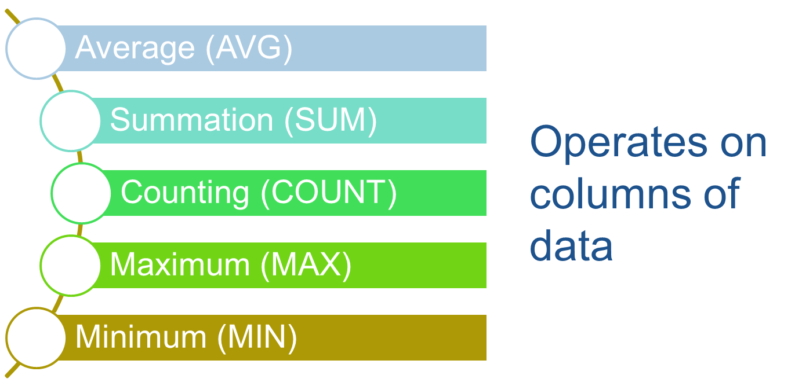
Aggregate functions

Slide 14

Aggregate functions
 | Column Expression (Argument to Aggregation Function)
Aggregate Function | Product_Code | Description | Unit_px | Accessory _px | (Unit_px + Accessory_px) * 5
 | HG5000 | Body Pants + bell | 10 | 5 | 75
 | RQ8996 | Dress Yellow | 25 | NULL | NULL
 | DT4000 | Top + Skirt White + necklace | 15 | 10 | 125
 | RQ7601 | Dress Colour | 30 | NULL | NULL
Sum | NA | NA | 80 | 15 | 200
Average | NA | NA | 20 | 7.5 | 100
Max | RQ8996 | Top + Skirt White + necklace | 30 | 10 | 125
Min | DT4000 | Body Pant + bell | 10 | 5 | 75
Count | 4 | 4 | 4 | 2 | 2
Count(*) | 4
Product

Slide 15
Aggregate functions - AVG (Column_Expression)
Product_Code | Description | Unit_px | Accessory _px
HG5000 | Body Pants + bell | 10 | 5
RQ8996 | Dress Yellow | 25 | NULL
DT4000 | Top + Skirt White + necklace | 15 | 10
RQ7601 | Dress Colour | 30 | NULL
What is the average Accessory_px for the products ?
Product
SQL
SELECT AVG(accessory_px) ‘Average Accessory Price’
FROM Product
Average Accessory Price
7.5
Average the NON-NULL values defined by the column expression
Resulting Table

Slide 16
Aggregate functions - SUM (Column_Expression)
Product_Code | Description | Unit_px | Accessory _px
HG5000 | Body Pants + bell | 10 | 5
RQ8996 | Dress Yellow | 25 | NULL
DT4000 | Top + Skirt White + necklace | 15 | 10
RQ7601 | Dress Colour | 30 | NULL
What is the sum of Accessory_px for the products ?
Product
SQL
SELECT SUM(accessory_px) ‘Total Accessory Price’
FROM Product
Total Accessory Price
15
Total the NON-NULL values defined by the column expression
Resulting Table

Slide 17
Aggregate functions - COUNT (Column_Expression)
Product_Code | Description | Unit_px | Accessory _px
HG5000 | Body Pants + bell | 10 | 5
RQ8996 | Dress Yellow | 25 | NULL
DT4000 | Top + Skirt White + necklace | 15 | 10
RQ7601 | Dress Colour | 30 | NULL
How many products have Accessory_px ?
Product
SQL
SELECT COUNT(accessory_px) ‘Number of products with accessory price’
FROM Product
Number of products with accessory price
2
Count the NON-NULL values defined by the column expression
Resulting Table

Slide 18
Aggregate functions COUNT (Column_Expression)
Product_Code | Description | Unit_px | Accessory _px
HG5000 | Body Pants + bell | 10 | NULL
RQ8996 | Dress Yellow | 25 | NULL
DT4000 | Top + Skirt White + necklace | 15 | NULL
RQ7601 | Dress Colour | 30 | NULL
Can I count the number of NULL?
Product
SQL
SELECT COUNT(accessory_px) ‘Number of NULL’
FROM Product
Number of NULL
0
Resulting Table

Slide 19
Aggregate function-MAX (column_expression) & MIN (column_expression)
Product_Code | Description | Unit_px | Accessory _px
HG5000 | Body Pants + bell | 10 | 5
RQ8996 | Dress Yellow | 25 | NULL
DT4000 | Top + Skirt White + necklace | 15 | 10
RQ7601 | Dress Colour | 30 | NULL
What is the highest and lowest accessory price?
Product
SQL
SELECT MAX(accessory_px) ‘Highest accessory price’
MIN(accessory_px) ‘Lowest accessory price’
FROM Product
Highest accessory price | Lowest accessory price
10 | 5
Return the HIGHEST/LOWEST NON-NULL values of the column expression of any data type (numeric, text or date)
Resulting Table

Slide 20
Aggregate function - Usage of DISTINCT keyword in Aggregate functions
Product_Code | Description | Type_Of_product | Unit_px | Accessory _px
HG5000 | Body Pants + bell | Pant | 10 | NULL
RQ8996 | Dress Yellow | Dress | 25 | NULL
DT4000 | Top + Skirt White + necklace | Top | 15 | NULL
RQ7601 | Dress Colour | Dress | 30 | NULL
Product
SQL
SELECT COUNT(type_of_product) ‘Number of product (Duplicates),
COUNT (DISTINCT type_of_product) ‘Number of product (No Duplicates)
FROM Product
Number of Product (Duplicates) | Number of product (No Duplicates)
4 | 3
If DISTINCT keyword is used in the column expression, then duplicate values of the column expression are ignored.
Resulting Table

Slide 21
Aggregate function - Usage of DISTINCT keyword in Aggregate functions
Product_Code | Description | Type_Of_product | Unit_px | Accessory _px
HG5000 | Body Pants + bell | Pant | 45 | 5
RQ8996 | Dress Yellow | Dress | 25 | NULL
DT4000 | Top + Skirt White + necklace | Top | 30 | 10
RQ7601 | Dress Colour | Dress | 25 | NULL
Product
SQL
SELECT AVG(unit_px) ‘Average unit price (Duplicates),
AVG (DISTINCT unit_px) ‘Average unit price (No Duplicates)
FROM Product
Average unit price (Duplicates) | Average unit price (No Duplicates)
30 | 33.33
(45+25+30) / 3
(45+25+30+25) / 4
Resulting Table

Slide 22
Summarizing results by group - Using GROUP BY clause
What is the average price and quantity for each
Supplier?
Stock
Prod_Code | Prod_Desc | Unit_px | Supplier_ID | Qty
HG7160 | Sale Dress White | 15.90 | S1001 | 30
HG9298 | Sale Top + Skirt Red | 19.80 | S1001 | 20
RQ0207 | Dress White | 18.60 | S1002 | 40
HG7166 | Dress Blue | 15.90 | NULL | 10
HG6159 | Sale Dress Pink | 15.40 | S1002 | 40
HT5402 | Pink Skirt | 15.00 | NULL | 20

Slide 23
Summarizing results by group - Using GROUP BY clause
Prod_Code | Prod_Desc | Unit_px | Supplier_ID | Qty
HG7160 | Sale Dress White | 15.90 | S1001 | 30
HG9298 | Sale Top + Skirt Red | 19.80 | S1001 | 20
RQ0207 | Dress White | 18.60 | S1002 | 40
HG7166 | Dress Blue | 15.90 | NULL | 10
HG6159 | Sale Dress Pink | 15.40 | S1002 | 40
HT5402 | Pink Skirt | 15.00 | NULL | 20
Stock
SQL | Syntax
SELECT Supplier_ID ‘Supplier ID’, | SELECT <List of Grouping columns>,
AVG(unit_px) ‘Average Unit Price’, AVG(qty) ‘Average Quantity’ | <Aggregate Function>
FROM stock | FROM <Table>
GROUP BY Supplier_ID | GROUP BY <List of Grouping Columns>
Grouping Attributes
Supplier ID | Average Unit Price | Average Quantity
NULL | 15.45 | 15
S1001 | 17.85 | 25
S1002 | 17 | 40
What is the average price and quantity for each supplier?
Resulting Table

Slide 24
Summarizing results by group - Using GROUP BY clause for Group Summary
SQL
SELECT Supplier_ID ‘Supplier ID’,
AVG(unit_px) ‘Average Unit Price’, AVG(qty) ‘Average Quantity’
FROM stock
GROUP BY Supplier_ID
Supplier ID | Average Unit Price | Average Quantity
NULL | 15.45 | 15
S1001 | 17.85 | 25
S1002 | 17 | 40
Resulting Table
GROUP BY queries uses a GROUP BY clause
Group rows by specific column values to produce a single summary row for each group
NULL values are grouped together as a NULL group

Slide 25
Summarizing results by group - Using HAVING clause for selecting group
Prod_Code | Prod_Desc | Unit_px | Supplier_ID | Qty
HG7160 | Sale Dress White | 15.90 | S1001 | 30
HG9298 | Sale Top + Skirt Red | 19.80 | S1001 | 20
RQ0207 | Dress White | 18.60 | S1002 | 40
HG7166 | Dress Blue | 15.90 | NULL | 10
HG6159 | Sale Dress Pink | 15.40 | S1002 | 40
HT5402 | Pink Skirt | 15.00 | NULL | 20
What is the average price and quantity for each supplier?
Display those average quantity that is more than 20
Stock
SQL | Syntax
SELECT Supplier_ID ‘Supplier ID’, | SELECT <List of Grouping columns>,
AVG(unit_px) ‘Average Unit Price’, AVG(qty) ‘Average quantity’ | <Aggregate Function>
FROM stock | FROM <Table>
GROUP BY Supplier_ID | GROUP BY <List of Grouping Columns>
HAVING AVG(qty) > 20 | HAVING <Group selection criteria>
Supplier ID | Average Unit Price | Average Quantity
S1001 | 17.85 | 25
S1002 | 17 | 40
NULL | 15.45 | 15
Resulting Table

Slide 26
Summarizing results by group - Using WHERE clause with GROUP BY
Prod_Code | Prod_Desc | Unit_px | Supplier_ID | Qty
HG7160 | Sale Dress White | 15.90 | S1001 | 30
HG9298 | Sale Top + Skirt Red | 19.80 | S1001 | 20
RQ0207 | Dress White | 18.60 | S1002 | 40
HG7166 | Dress Blue | 15.90 | NULL | 10
HG6159 | Sale Dress Pink | 15.40 | S1002 | 40
HT5402 | Pink Skirt | 15.00 | NULL | 20
What is the average price and quantity for each supplier?
Display only those average quantity that is more than 20 and exclude those without supplier ID. Sort the supplier ID in descending order.
Stock
SQL | Syntax
SELECT Supplier_ID ‘Supplier ID’, | SELECT <List of Grouping columns>,
AVG(unit_px) ‘Average Unit Price’, AVG(qty) ‘Average quantity’ | <Aggregate Function>
FROM stock | FROM <Table>
WHERE Supplier_ID IS NOT NULL | WHERE <row selection criteria>
GROUP BY Supplier_ID | GROUP BY <List of Grouping Columns>
HAVING AVG(qty) > 20 | HAVING <Group selection criteria>
ORDER BY Supplier_ID DESC | ORDER BY <Sorting criteria>
So what is the result?

Slide 27
Summarizing results by group - Using WHERE clause with GROUP BY (Step 1)
Stock
Prod_Code | Prod_Desc | Unit_px | Supplier_ID | Qty
HG7160 | Sale Dress White | 15.90 | S1001 | 30
HG9298 | Sale Top + Skirt Red | 19.80 | S1001 | 20
RQ0207 | Dress White | 18.60 | S1002 | 40
HG7166 | Dress Blue | 15.90 | NULL | 10
HG6159 | Sale Dress Pink | 15.40 | S1002 | 40
HT5402 | Pink Skirt | 15.00 | NULL | 20
WHERE Supplier_ID is not null
Intermediate Table 1
Prod_Code | Prod_Desc | Unit_px | Supplier_ID | Qty
HG7160 | Sale Dress White | 15.90 | S1001 | 30
HG9298 | Sale Top + Skirt Red | 19.80 | S1001 | 20
RQ0207 | Dress White | 18.60 | S1002 | 40
HG7166 | Dress Blue | 15.90 | NULL | 10
HG6159 | Sale Dress Pink | 15.40 | S1002 | 40
HT5402 | Pink Skirt | 15.00 | NULL | 20

Slide 28
Summarizing results by group - Using WHERE clause with GROUP BY (Step 2)
Intermediate Table 1
GROUP BY Supplier_ID
Prod_Code | Prod_Desc | Unit_px | Supplier_ID | Qty
HG7160 | Sale Dress White | 15.90 | S1001 | 30
HG9298 | Sale Top + Skirt Red | 19.80 | S1001 | 20
RQ0207 | Dress White | 18.60 | S1002 | 40
HG6159 | Sale Dress Pink | 15.40 | S1002 | 40
Intermediate Table 2
Supplier_ID | Average Unit Price | Average Quantity
S1001 | 17.85 | 25
S1002 | 17 | 40

Slide 29
Summarizing results by group - Using WHERE clause with GROUP BY (Step 3)
Intermediate Table 2
HAVING Avg(Qty) > 20
Supplier_ID | Average Unit Price | Average Quantity
S1002 | 17 | 40
S1001 | 17.85 | 25
Intermediate Table 3
Supplier_ID | Average Unit Price | Average Quantity
S1001 | 17.85 | 25
S1002 | 17 | 40
Result table
ORDER BY Supplier_ID DESC
Supplier_ID | Average Unit Price | Average Quantity
S1002 | 17 | 40
S1001 | 17.85 | 25

Slide 30
Summarizing results by group - Difference between WHERE and HAVING clauses
WHERE clause is executed first to filter rows before grouping them
HAVING clause filters groups for display

Slide 31
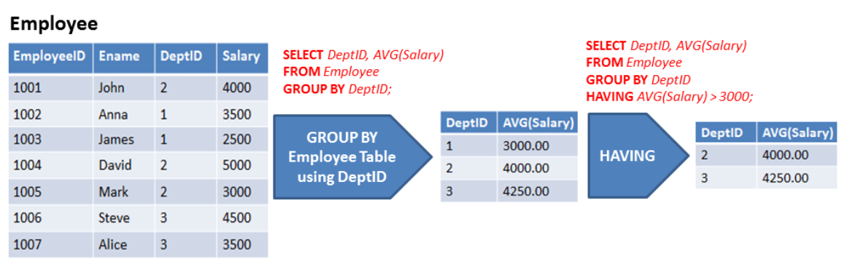
More examples

